Slide 1

What’s New in Worldview
Zachary Rice
ASRC Federal
SE TIM 2018
August 29th, 2018
Notes:
Hello Everyone
I’m Zach Rice, one of the developers on the Worldview Team.
And, today I’m going to talk about What’s New in Worldview.

Slide 2
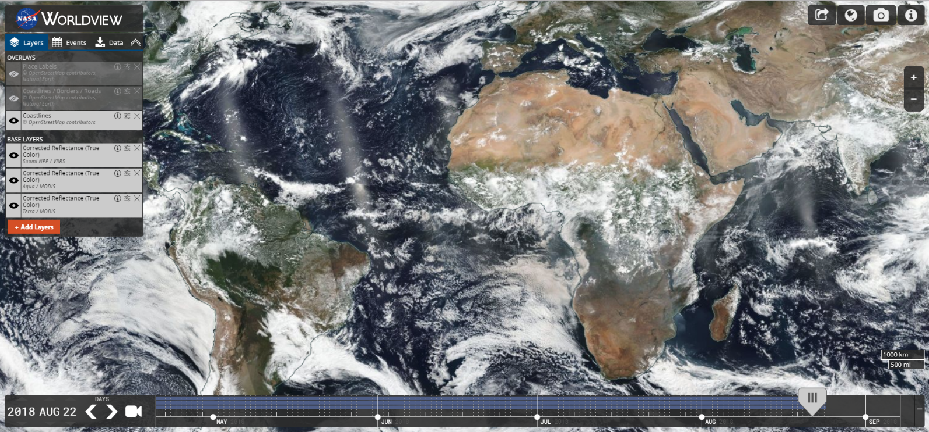




Major Releases
v2.0.0 & v2.1.0
Refactored codebase to use ES6 modules
Simplified build scripts
Improved developer tools
v2.2.0
Improved Snapshot & GIF resolution
v2.3.0
Geostationary imagery support
v2.4.0 & v2.5.0
Multi-day event tracking
v2.6.0
Natural events in polar projection views
v2.7.0
Vector layer support
v2.8.0
Support selecting layers with future dates
v2.9.0 (September 2018)
“A|B” Comparison Mode
Notes:
So, Let’s Get Started.
This year we have had 9 major releases since January.
We started the year with the 2.0 major release.
This release focused on refactoring JavaScript ES5 code to ES6, simplifying build scripts and improving developer tools.
We were able to develop features quicker by utilizing linter files, adding a watch mode, and better handling build script errors. We were able to achieve a lighter weight application by using JavaScript modules which allowed us to only pull in individual modules from larger JavaScript libraries.
So, this release set the foundation for what was to come the rest of the year.
Notable features which followed the 2.0 release, and which we will cover in this talk, include:
- Improved Snapshot & GIF resolutions
- Geostationary imagery support
- Multi-day event tracking
- Support for natural events in the polar projection views
- Vector layer support
- Our upcoming comparison feature
As well as a few other Worldview related projects

Slide 3
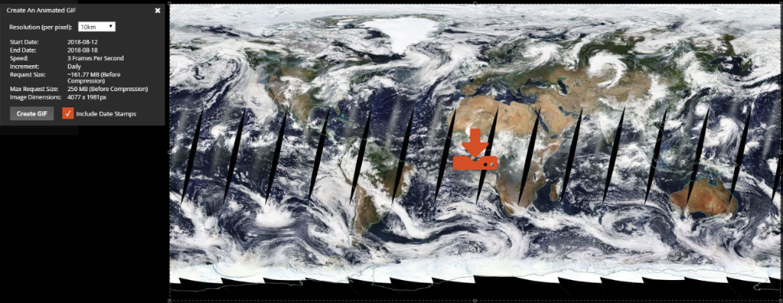
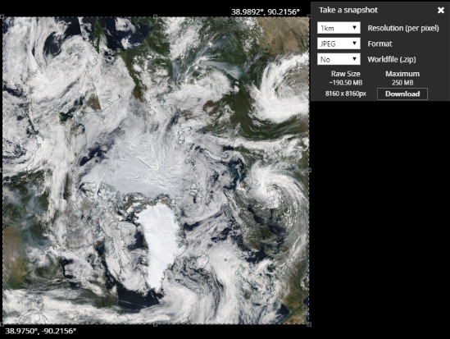
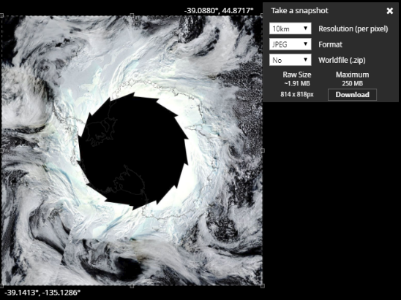
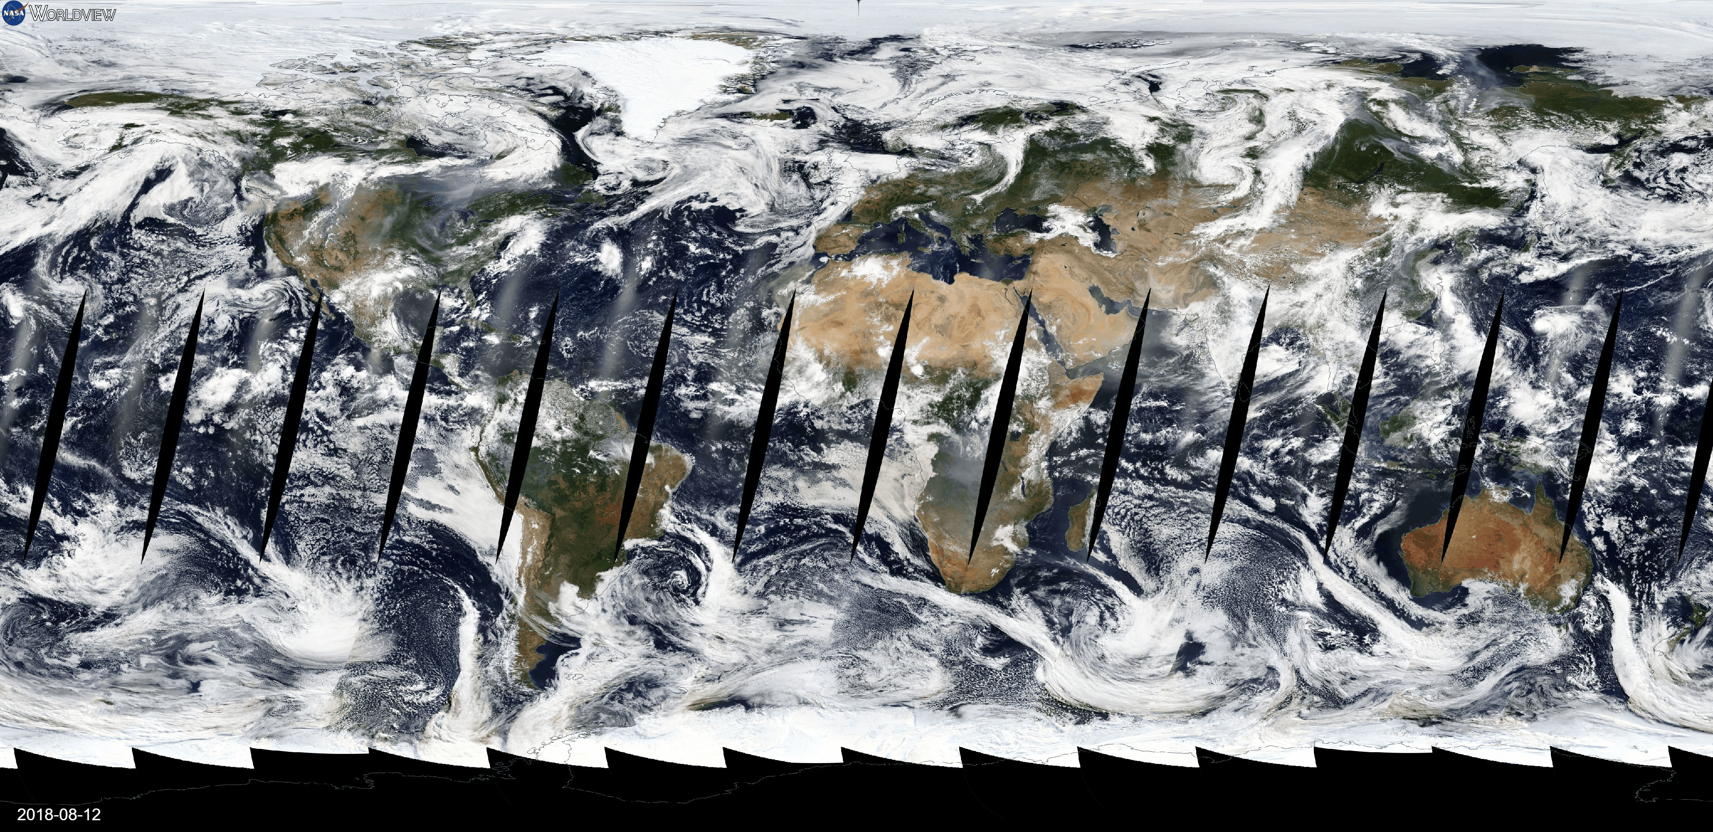
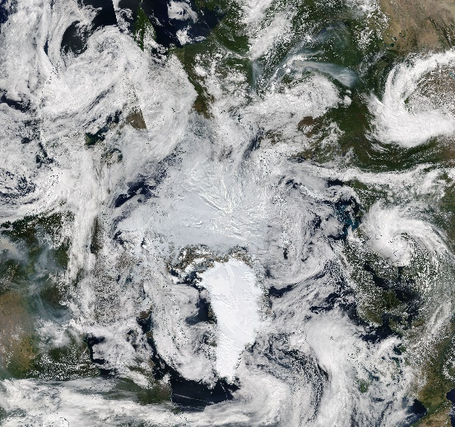
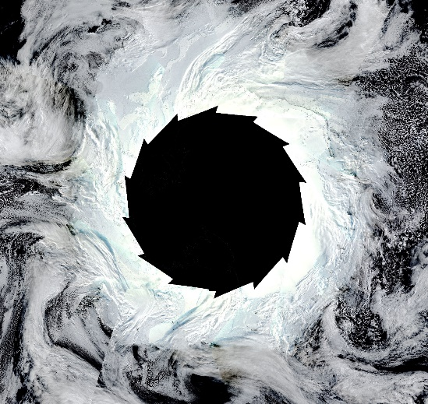
Improved Image Resolution
High-Resolution Animated GIFs
High-Resolution Image Snapshots
7-Day Animation of Geographic Projection at 10km
Arctic & Antarctic Projections at 1km
Notes:
So, Version 2.2 introduced a higher capacity image-download method.
Previously we had a limit of about 40MB uncompressed, which sounds quite large but there was a growing number of users who were hitting this limit, especially when using the animated GIF feature.
The new limit will implemented allows a user to request an image at a size of 250MB uncompressed. And, what the user actually receives is a smaller, compressed size.
So, as you see on the left, that animated GIF is 7-days worth of imagery at 10km resolution for the entire Geographic projection.
On the right, these images are of the entire polar projection at a 1km resolution.
Both of which would not have been achievable in the past.
Our original implementation of the animated GIF feature relied on an open-source library originally developed at Yahoo called GitShot. Initially we worked with the maintainers of this library to add increased capacities, but technical deviations on how they wanted to implement certain features saw us develop our own solution out.

Slide 4
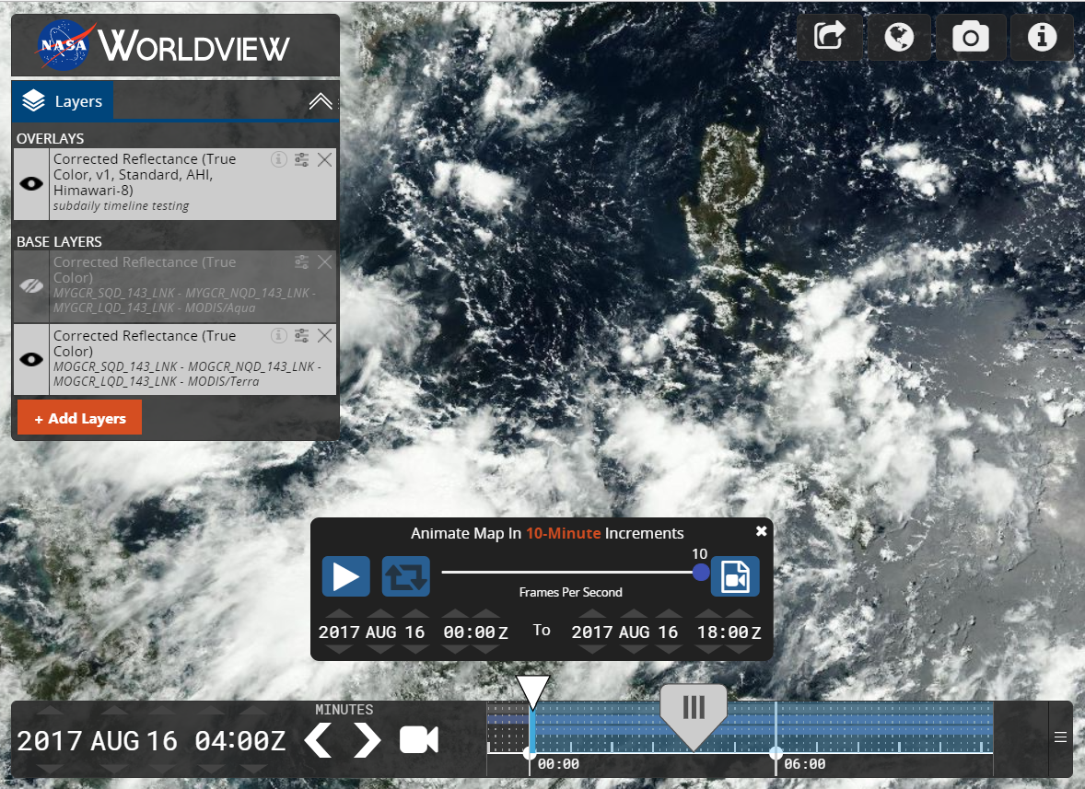
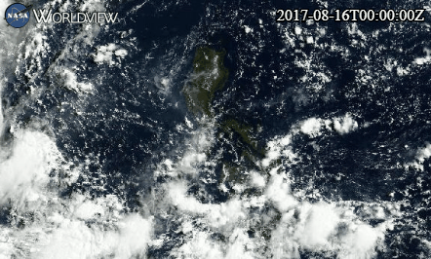
Geostationary Imagery Support
10-minute timeline granularity for NASA CAMP2Ex field campaign
Notes:
Version 2.3 saw the implementation of geostationary imagery support. This was specifically to accommodate the work of the NASA CAMP2Ex team who had hoped to stand-up their own Worldview to view sub-daily, geostationary imagery.
As you can see in the top right image, we are now able to show layers at a minute interval, (10-minute intervals with the Himawari layer being shown), compared to a 1-day interval shown below that. This greatly increases the amount of visual data that can be extrapolated; such as cloud formation, wind direction, and even the movement of the sun as it is reflected off of the Earth’s surface.
In the left image, you can see how the timeline adapts based on the availability of a sub-daily layer in the layer list. We now have a ‘Minutes’ zoom-level; there is an hour and minute field on the timeline, and the animation widget allows for a minute-base range.
Let’s see how this looks within the application…

Slide 5
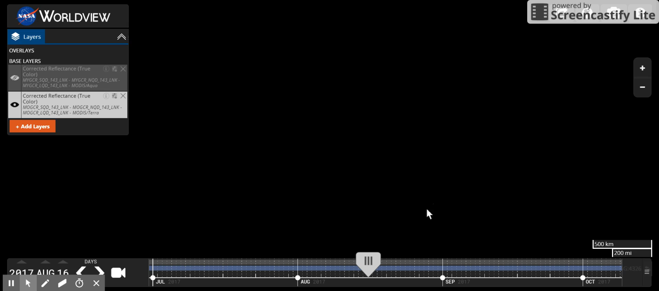
Geostationary Imagery Support
Notes:
So starting out, the timeline has 3 zoom levels; daily, monthly, yearly. There is also the standard year, month, day selectors.
But if we add a layer with sub-daily intervals, we can see the timeline adapts. There is now hour and minute selectors as well as a new minutes zoom level.
And then, you can see dragging the pick on the timeline shows a new layer for every 10-minute interval.
And, if we build an animation, the imagery will animate at that 10-minute intervals. And this creates stunning visuals which can be saved as an animated GIF.
Ok, moving on…

Slide 6
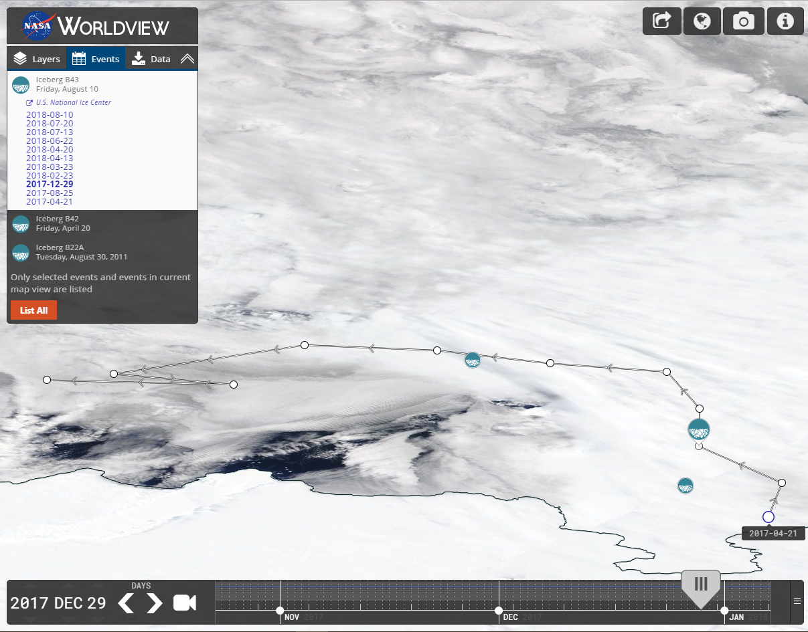
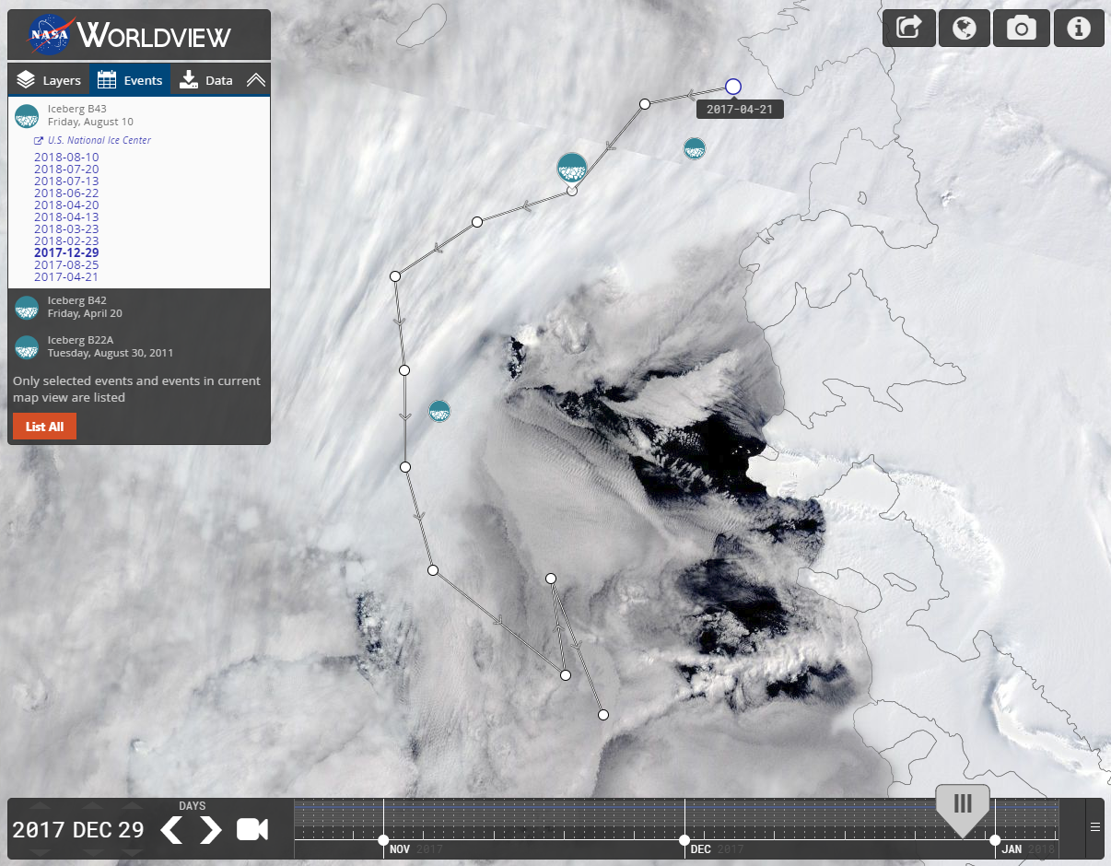
Event Tracks & Polar Events
Event Tracking
Polar Projection Support
Notes:
Our next major feature was the ability to track events over time; first introduce in version 2.4.
So, within Worldview we show major events such as Volcanos, Hurricanes, Dust Storms, etc. With multi-day events such as icebergs and severe storms, it was difficult to see the movement of these events over-time. Most of these events occur for multiple days and, sometimes over the course of years, in the case of Icebergs.
These event dates have always been tracked in the event’s listing and shown as an icon on the map but there was never a way to visualize the distance an event has moved. With this feature, when a user clicks a multi-day event, you will see a line connecting those days and clicking the points on the line, jumps you to that day. And on that event track line, you are able to see the direction in with the event is moving as well.
In addition to improving the temporal context of an event; version 2.6 added the ability to view events within the polar projections. Previously, events were only viewable in the Geographic projection.
So, the image on the left image is showing an iceberg as viewed in the Geographic projection; the right image shows the same event as seen in the Antarctic Projection.

Slide 7
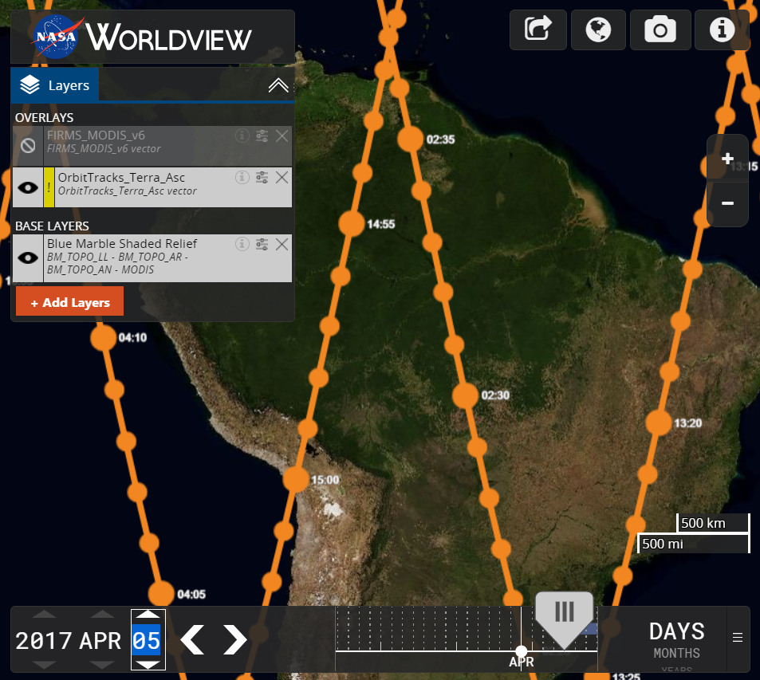
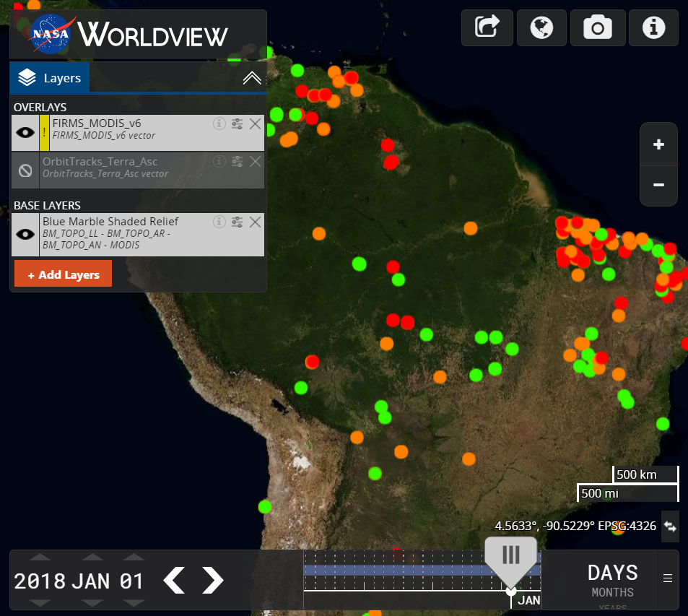
Vector Support
Orbit Tracks
FIRMS MODIS v6 Fires
Notes:
Next up we have vector support.
Version 2.7 added basic, unstyled, vector layer support and more advanced feature development is ongoing. The images above, for example, demonstrate the capabilities we have achieved while prototyping styled vector layers.
On the left, we see the Terra Ascending Orbit Track layer with a line showing the path of the satellite, as well as points styled at 1 and 5 minute intervals with labels added every 5 minutes.
On the right, we see the FIRMS MODIS layer with fires styled by color based on their confidence level.
So, how do we style vectors?
With map vector tiles, data about the layer is encoded within each tile. We then use a separate style JSON file to define styles and map those styles to features. In our orbit track example, a time value is encoded into the MVT as a regular expression; as well as a color value, and size in order to render the circle and labels you see. This information is passed to OpenLayers when the tile is being rendered and it is cached in an array of points.
The result is super-fast rendering and styling of thousands of points at once.

Slide 8
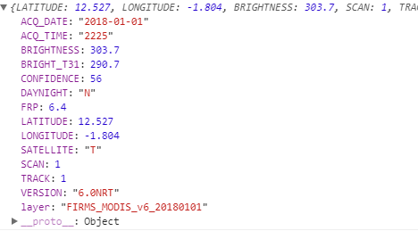
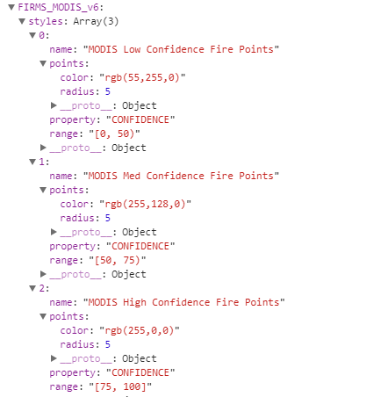
Vector Support
Composing a stylized vector layer
Vector Point Feature Data
JSON Style Data
Match vector feature data to the style JSON data
In the FIRMS_MODIS example, we match “CONFIDENCE”
Based on the CONFIDENCE number, we style with 1 of 3 colors
Notes:
So, let’s dig deeper into composing a stylized vector layer.
On the left, there is an example of feature data encoded within a vector tile. You can see there is information such as date, time, brightness, confidence level etc.
On the right, is a JSON file we created to be used consumed by OpenLayers to style the vector points.
In the case of fires, we have 3 styles defined, “Low Confidence, Medium Confidence, and High Confidence”. Each style has color, radius, property and range values defined.
If you notice, the property value within the style JSON is matched to the property vector feature data key of the same name; in this case CONFIDENCE.
That CONFIDENCE value within the MVT is compared to each style’s range of values.
So, for example, if the MVT Confidence value is “56”, then that point of data will be styled with “Medium Confidence”. Which means an orange point will be rendered as that is what is defined within the “color” and “radius” fields in the style JSON.

Slide 9
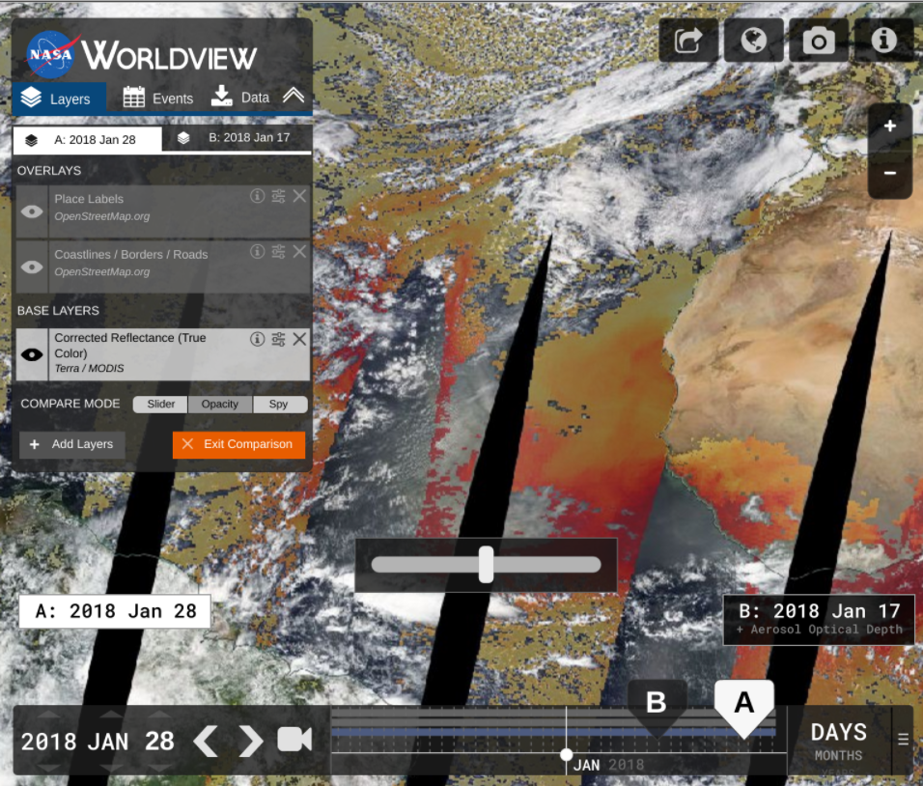
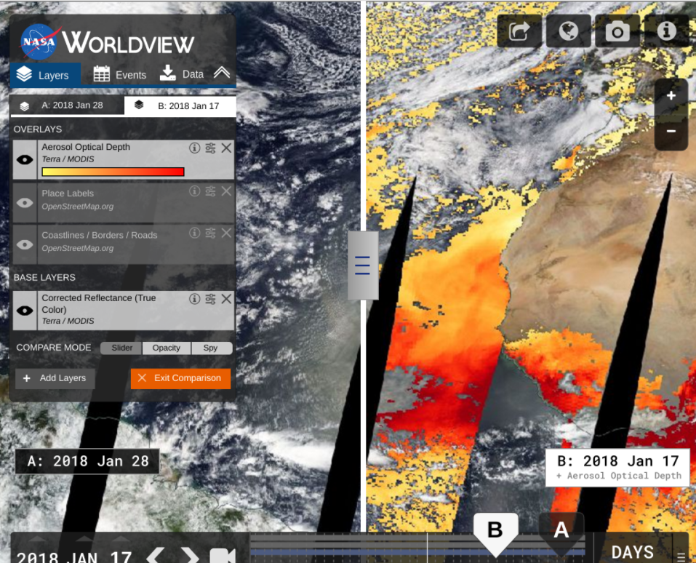
Comparison Mode (Sept 2018)
Opacity Mode
Swipe Mode
Notes:
The next feature we are very excited to show is our new Comparison Mode which will debut in our September release. This feature enables the user to compare 2 states of the application using 3 different methods of comparison. Once the feature is enabled by the user, a State A & State B will appear which can be setup independently with separate layer lists and different dates. This gives the user the ability to compare data by time, by layer, or both.
The left image above shows the opacity mode. Opacity mode will allow the user to fade between the “A” layer and the “B” layer using the slider above the timeline.
The image on the right shows the slider mode. Slider mode allows the user to grab the divider and swipe left and right across the map.
The third mode is the “spy” mode which brings up a circle region containing the State B when State A is the main layer shown. This allows the user to hover over a very specific region at a time.

Slide 10
New Layers
Over 80 new layers added since January…
SEDAC (36 Layers)* *Replaced many of the WMS layers with WMTS layers, but also added a lot more new layers that Worldview did not have before.
Croplands
Pastures
Anthropogenic Biomes
Drought Hazard
Flood Hazard
Landslide Hazard
Estimated Net Migration by Decade: 1970-1980
Estimated Net Migration by Decade: 1980-1990
Estimated Net Migration by Decade: 1990-2000
Population Density, 2000
Population Density, 2005
Population Density, 2010
Population Density, 2015
Population Density, 2020
Human Footprint
Last of the Wild
Urban Extents
Urban-Rural Extents below 10m
Probabilities of Urban Expansion, 2000-2030
Particulate Matter below 2.5µm, 2001-2010
Particulate Matter below 2.5µm, 2010-2012
Mangrove Forest Distribution, 2000
Summer Day Maximum Land Surface Temperature, 2013
Summer Night Minimum Land Surface Temperature, 2013
Ground Level Nitrogen Dioxide, 3 Years Running Mean 1996-1998
Ground Level Nitrogen Dioxide, 3 Years Running Mean 2010-2012
Amphibian Richness: All Species, Vulnerable Species, Critically Endangered Species, Endangered Species, All Threats
Mammal Richness: All Species, Vulnerable Species, Critically Endangered Species, Endangered Species, All Threats
PO.DAAC (24 layers)
Sea Surface Currents (Zonal), OSCAR
Sea Surface Currents (Meridional), OSCAR
Sea Surface Height Anomalies (GDR Cycles), TOPEX/POSEIDON, JASON-1, OSTM/Jason-2, and Jason-3
Sea Surface Height Anomalies (US West Coast, GAFECC), TOPEX/POSEIDON, JASON-1, OSTM/Jason-2
Sea Surface Currents (Zonal, US West Coast, GAFECC) , TOPEX/POSEIDON, JASON-1, OSTM/Jason-2
Sea Surface Currents (Meridional, US West Coast, GAFECC) , TOPEX/POSEIDON, JASON-1, OSTM/Jason-2
Sea Surface Height Anomalies (Reconstructed) , TOPEX/POSEIDON, JASON-1, OSTM/Jason-2
Absolute Dynamic Topography (AVISO ADT)
Liquid Water Equivalent Thickness (Mascon, CRI), GRACE Tellus
Liquid Water Equivalent Thickness (Mascon) , GRACE Tellus
Liquid Water Equivalent Thickness (Land, GFZ) , GRACE Tellus
Liquid Water Equivalent Thickness (Land, JPL) , GRACE Tellus
Liquid Water Equivalent Thickness (Land, CSR) , GRACE Tellus
Liquid Water Equivalent Thickness (Ocean, GFZ) , GRACE Tellus
Liquid Water Equivalent Thickness (Ocean, JPL) , GRACE Tellus
Liquid Water Equivalent Thickness (Ocean, CSR) , GRACE Tellus
Liquid Water Equivalent Thickness (Ocean, EOF, GFZ) , GRACE Tellus
Liquid Water Equivalent Thickness (Ocean, EOF, JPL) , GRACE Tellus
Liquid Water Equivalent Thickness (Ocean, EOF, CSR) , GRACE Tellus
Sea Surface Salinity (L3, Monthly, Radiometer), SMAP
Sea Surface Salinity (L3, 8-Day Running Mean, Radiometer), SMAP
Sea Surface Salinity (L3, CAP, Monthly), SMAP
Sea Surface Salinity (L3, CAP, 8-Day Running Mean), SMAP
Sea Surface Temperature (L4), GHRSST
AMSR2 LPRM (4 Layers)
Surface Soil Moisture C1-Band (Night, Daily)
Surface Soil Moisture C1-Band (Day, Daily)
Downscaled Surface Soil Moisture C1-Band (Night, Daily)
Downscaled Surface Soil Moisture C1-Band (Day, Daily)
GHRC LIS (4 Layers)
TRMM LIS Flash Radiance (Level 2, Standard)
Calibrated Flash Radiance (OTD / Microlab-1)
DMSP-F12 OLS Digital Derived Lightning (Level 3)
DMSP-F10 OLS Digital Derived Lightning (Level 3)
SMAP Geographic (4 Layers)
Freeze/Thaw, Day (L3, Passive, Radiometer)
Freeze/Thaw, Night (L3, Passive, Radiometer)
Freeze/Thaw, Day (L3, Passive Enhanced, Radiometer)
Freeze/Thaw, Night (L3, Passive Enhanced, Radiometer)
Orbit tracks (12 layers)
Landsat 7 Orbital Tracks (Ascending/Night)
Landsat 7 Orbital Tracks (Descending/Day)
Sentinel-2A Orbital Track (Descending/Day)
Sentinel-2A Orbital Track (Ascending/Night)
Sentinel-2B Orbital Track (Descending/Day)
Sentinel-2B Orbital Track (Ascending/Night)
Sentinel-5P Orbital Track (Descending/Night)
Sentinel-5P Orbital Track (Ascending/Day)
NOAA-20 Orbital Tracks (Ascending/Day)
NOAA-20 Orbital Tracks (Descending/Night)
Notes:
Of course, Worldview’s best feature is the ability to view layers. And we have added quite a few since January as you can see. Over 80 layers in total….

Slide 11
New Layers
…and 30 more in our next release!
MERRA-2 (cont.)
- Total Aerosol Optical Thickness Extinction 550nm (Monthly)
- Total Dust Deposition, Dry+Wet Bins (Monthly)
- Evaporation from Turbulence (Monthly)
- Surface Albedo (Monthly)
- Carbon Monoxide Emission ENSEMBLE (Monthly)
- ISCCP Cloud Albedo (Monthly)
- Snow Depth Over Glaciated Surface (Monthly)
- Open Water Latent Energy Flux (Monthly)
- Total Precipitable Water Vapor (Monthly)
- 2 meter Air Temperature, Assimilated (Monthly)
- Aerosol Optical Depth Analysis (Monthly)
- Surface Wind Speed (Monthly)
- Air Temperature at 250hPa (Monthly)
- Ozone Mixing Ratio at 50hPa (Monthly)
- Relative Humidity after Moist at 700hPa (Monthly)
- Convective Rainwater Source at 700hPa (Monthly)
OMPS (1 layer)
- Aerosol Index (PyroCumuloNimbus)
AMSR2 (4 layers)
- Sea Ice Concentration (12 km), AMSR2, Unified algorithm
- Sea Ice Concentration (25 km), AMSR2, Unified algorithm
- Brightness Temperature for Sea ice (89H GHz), ASMR2, Unified algorithm
- Brightness Temperature for Sea ice (89V GHz), ASMR2, Unified algorithm
MERRA-2 (25 layers)
- 2m Air Temperature (Monthly)
- Total Precipitation Bias Corrected (Monthly)
- Snowfall (Monthly)
- Soil Water Root Zone (Monthly)
- Evaporation over Land (Monthly)
- SO2 Column Mass Density ENSEMBLE (Monthly)
- Dust Surface Mass Concentration PM2.5 (Monthly)
- Dust Surface Mass Concentration (Monthly)
- Total Aerosol Optical Thickness Scattering 550nm (Monthly)
Notes:
…And we will be adding 30 more in our next release.
So, what are people looking at in Worldview?

Slide 12
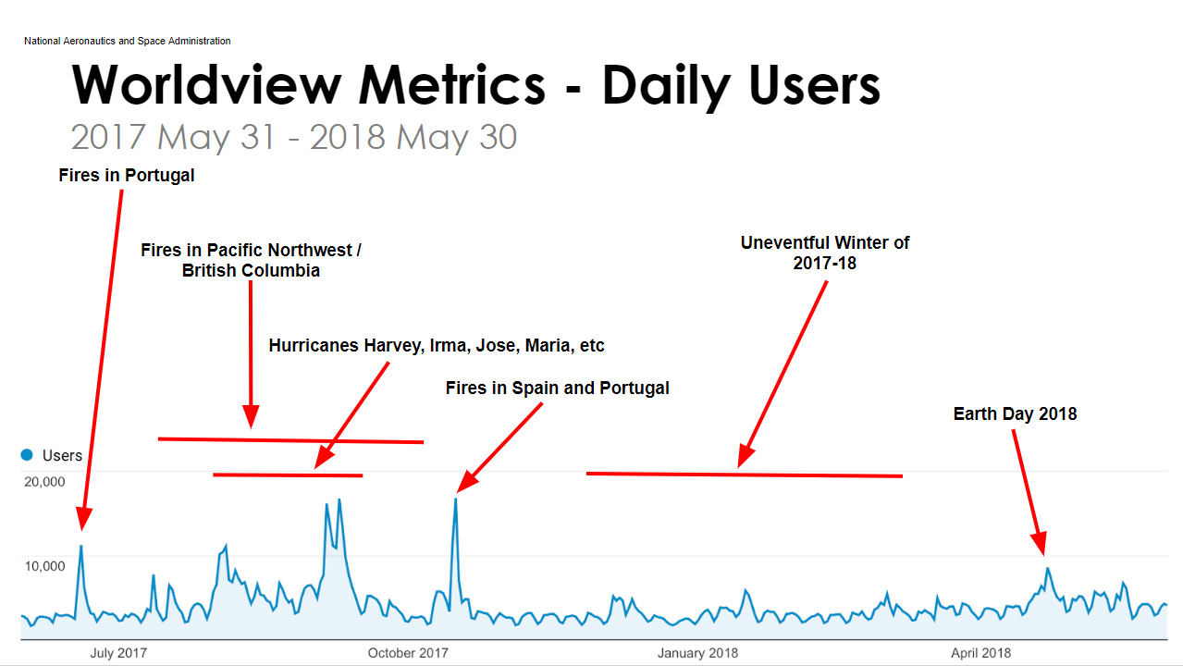
Metrics
Notes:
Here is a look at the Daily User metrics in Worldview. As you can see, we have about 3500 users on average a day but we get significantly more users during major events.
We have seen daily users rise to over 15,000 users a day during events such as Hurricane Harvey, Irma, Jose and Maria as well as during the Fires in Spain in Portugal in 2017.

Slide 13
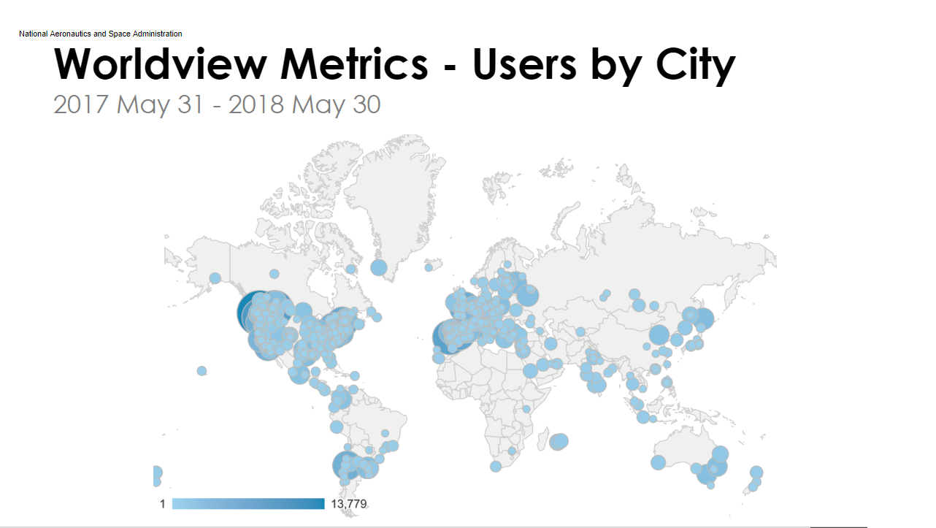
Metrics
Notes:
And, here is a view of users by city over the same time period. We see a large number of individuals from California and British Columbia as there were fires in those regions as well as a concentration of users in Spain and Portugal because of the fires there as well.

Slide 14
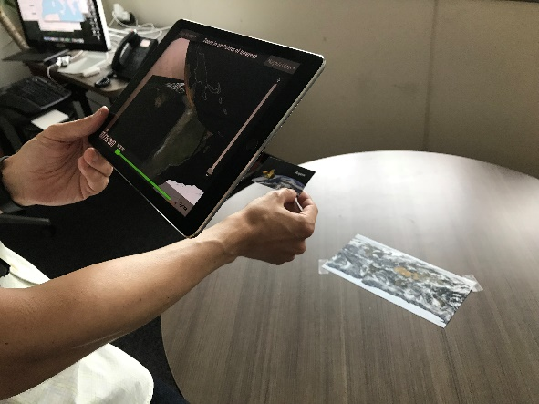
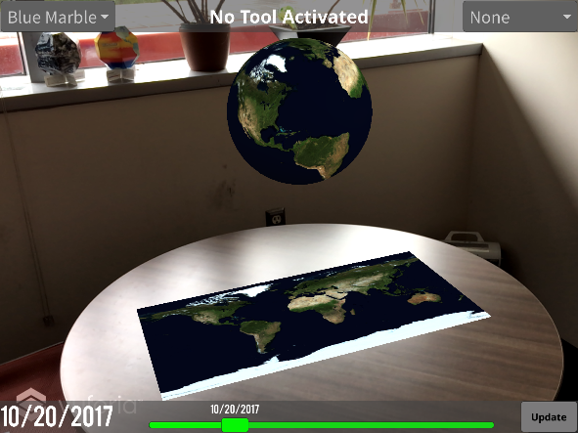
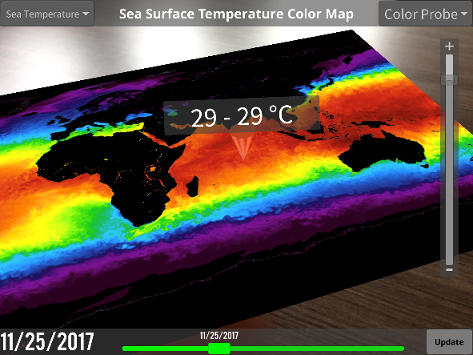
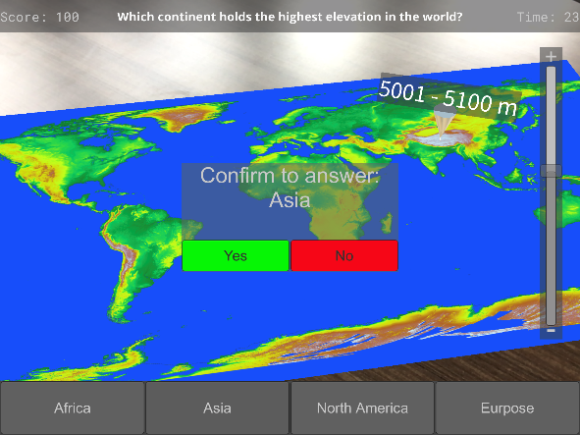
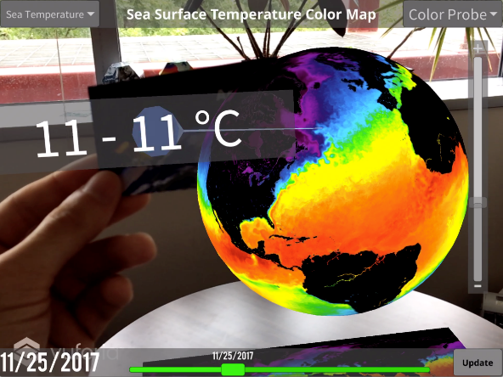
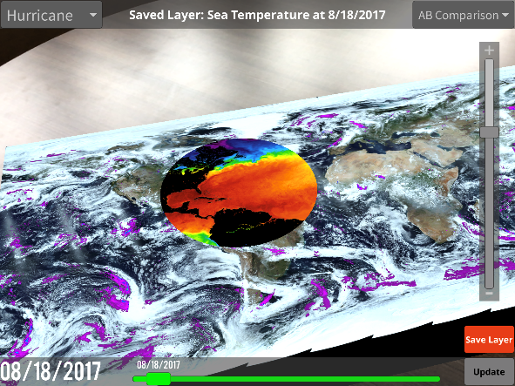
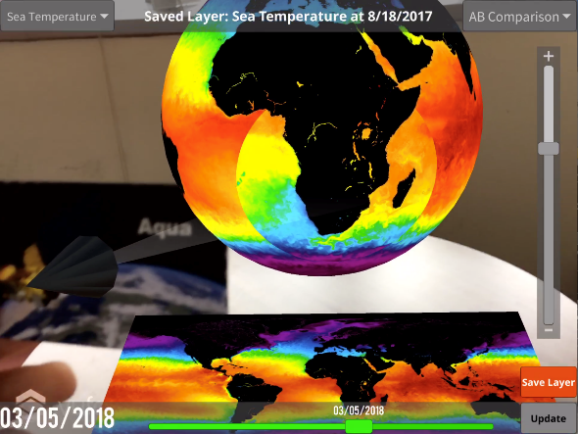
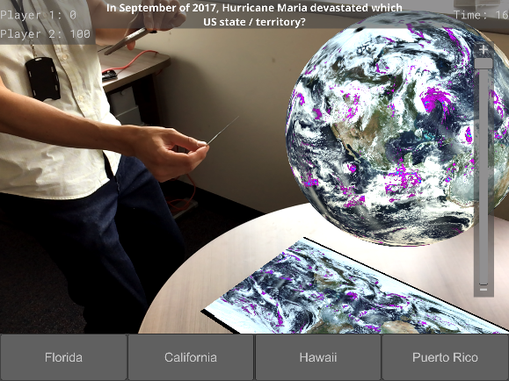
Worldview AR
Using Worldview AR
Application created by summer intern Jack Miller
Notes:
In addition to features developed and available in Worldview, we have also been busy working on other projects.
One of those projects was the development of Worldview AR which was created by our summer intern Jack Miller using the Unity 3D modeling tool.
This application displays GIBS layers through your phone in an augmented view using the camera on your phone or tablet to display either a floating virtual Globe or a virtual map. The application is designed to work with image targets; unique printable pieces of paper that can be used to add overlays or work as a magnifying glass to zoom into regions.
There is even a multi-player mode where multiple devices can be connected to the same AR instance. This multiple player mode allows users to interact together and a trivia game mode was built, making learning about our world fun and interactive.
You can download the app now at apps.nasa.gov

Slide 15
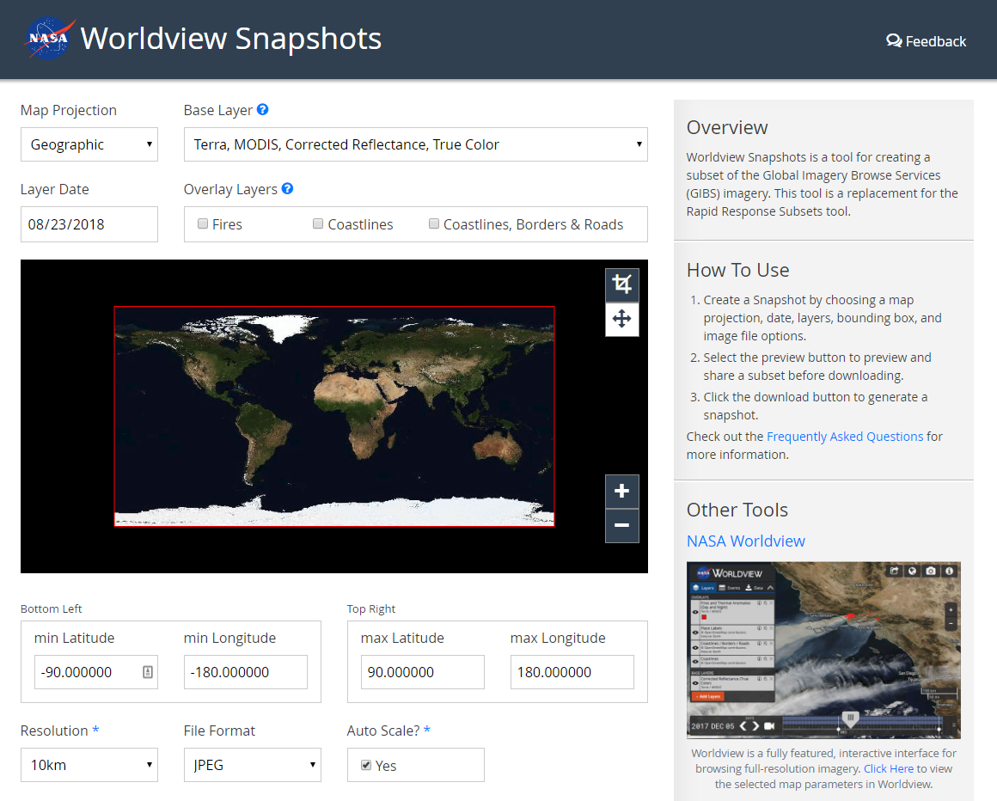
Short-Term Goals
Worldview Snapshots Tool
Startup Tour/Tutorial
Show users new / popular events
Advanced Vector Support
Styling based on vector features
Vector point tooltips
Revamped Image Download
Capture imagery across the dateline
Vector download capabilities
Add additional meta to downloads (legends, color bars, time stamps, etc.)
Updates to OpenStreetMap Layers
Notes:
So, what’s next?
I mentioned we were working on a few other projects in addition to just new features. One was Worldview AR, another is a new tool we are working on called Worldview Snapshots, which Mike will demo in a minute. This tool is designed to take the place of the Rapid Response tool with the goal of remaining lightweight and accessible to a large range of users. We are looking for beta-testers, so please get in touch with us if you are interested.
We are also in the process of designing a new tour. This new tour is being designed to encourage users to explore new events; during that exploration, the tour will also teach the user how to use a various features of the app that they might not normally use.
Next up, is continuing our development of vector layers. Incorporating some of the styling techniques shown earlier using the Mapbox style specification. We will also be exploring other features such as allowing users to inspect the information encoded in the vector points.
Revamping image download is also priority. Our users have requested some features including the ability to capture imagery across the dateline and add metadata over the image such as legends, color bars, and time stamps. And, with the addition of vector layer support, we will also add the ability to download those layers.

Slide 16
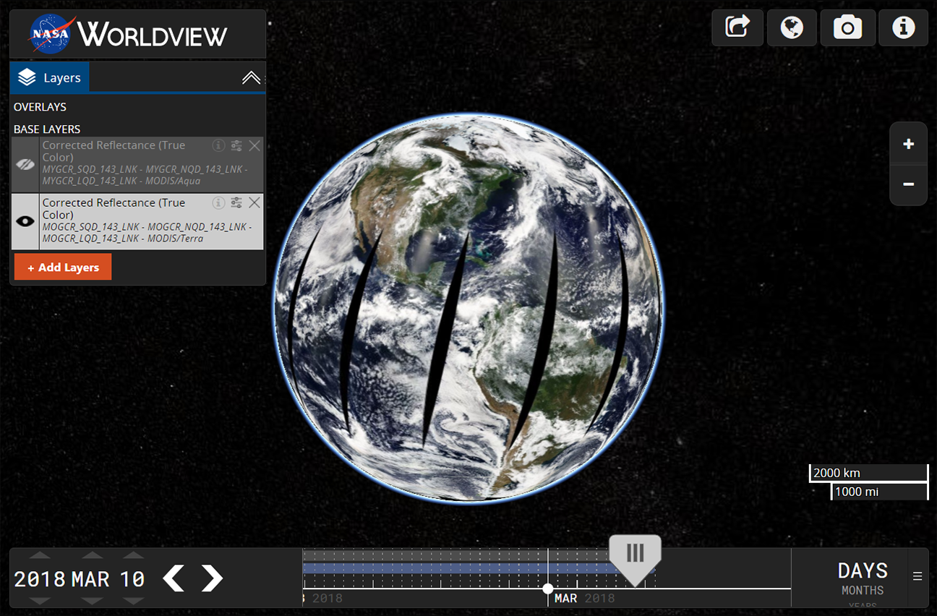
Mid to Long-Term Goals
Historical Event Browsing
Migration to NGAP
UI Overhaul
Improved Data Download
Improved Timeline
Gazetteer / Omni search box
Search for places, lat/long, layers, etc.
User Customization
Save settings, bookmarks, etc.
Crowdsource event information
Virtual Globe / Data Curtains
Add features that support new missions…
Worldview 3D globe concept using Cesium
Notes:
There are many more features which we are looking to incorporate in the mid-to-long term.
[List out features]
Historical event browsing, migration to NGAP, a UI overhaul, improved data download, improved timeline, an omni search box, user customizations, crowdsources event information, a virtual globe and data curtains, and any features that are needed to support new missions.

Slide 17
Thank You
More Resources & Links
Worldview on GitHub: https://github.com/nasa-gibs/worldview Release Notes: https://github.com/nasa-gibs/worldview/releases Project Roadmap: https://github.com/nasa-gibs/worldview/projects/7
Notes:
So, I would like to Thank you for your time.
One thing to note is Worldview is open-source and available on GitHub. So, if you have an idea or want to contribute, I highly recommend you go there and check out the project. You can also go there to review our release notes or open a ticket to request a feature or report a bug.
So again, thanks for your time, and I’ll hand it over to Mike for the Snapshots demo.

